Slide 1
Microwave Theory and Techniques 18ECC302J
Session 2
History of Microwave Engineering, Microwave transmission and Applications; Maxwell Equations

Slide 2
History of Microwave Engineering

Slide 3
History of Microwave Engineering
Microwaves are electromagnetic waves whose frequencies range from 1GHz to 1000GHz.The wavelength of λ of cm waves at microwave frequencies are very short typically from a few tens of cm to a fraction of mm.
Microwaves are electromagnetic waves. Hence, the history of microwaves embodied in the evolution of electromagnetic waves.
James Clerk Maxwell (1831-1879) unified all previous known results, experimental and theoretical on electromagnetic waves in four equations and predicted the existence of electromagnetic waves
Heinrich Rudolf Hertz (1857-1937) experimentally confirmed Maxwell’s prediction.
Guglielmo Marconi (1874-1937) transmitted information on an experimental basis at microwave frequencies.

Slide 4
Continue…
George C.Southworth (1930) really carried out Marconi’s experiments on a commercial basis.
In 1935 A.A.Heil and O.Heil suggested that microwave voltages be generated by using transit time effects together with lumped tuned circuits.
In 1939 W.C.Hahn and G.F .Metcalf proposed a theory of velocity modulation for microwave tubes.
Four months later R.H .Varian and S.F.Varian described a two cavity klystron amplifier and oscillator by using velocity modulation.
In 1944 R.Kompfner invented the helix type travelling wave tube .
During World War-II (1945) based on the previous developments ,radar was invented and was exploited for military applications.

Slide 5
Continue…
Historically microwave generation and amplification were accomplished by means of velocity modulation theory.
In the past two decades, however, microwave solid state devices such as tunnel diodes, Gunn diodes, transferred electron devices (TEDs), and avalanche transit time devices have been developed to perform these functions.
B.K.Ridley and T.B.Watkins in 1961 and C.Hilsum in 1962 independently predicted that the transferred electron effect would occur in GaAs. In 1963 J.B.Gunn reported his Gunn effect.

Slide 6
Continue…
The common characteristic of all microwave solid state devices is the negative resistance that can be used for microwave oscillation and amplification.
The progress of TEDs and avalanche transit time devices has been so swift that today they are firmly established as one of the most important classes of microwave solid state devices.

Slide 7
Microwave Transmission

Slide 8
Features of Microwave
In the electromagnetic spectrum, waves within the frequencies 1GHz to 300GHz are called microwaves.
Microwaves travel in straight lines, and so the transmitter and receiver stations should be accurately aligned to each other.
Microwave propagation is line of sight(LOS) propagation. So, towers hoisting the stations should be placed so that the curvature of the earth or any other obstacle does not interfere with the communication.

Slide 9
Features of Microwave
Since it is unidirectional, it allows multiple receivers in a row to receive the signals without interference.
Microwaves do not pass through buildings. So, indoor receivers cannot be used effectively.
Microwaves are often refracted by the atmospheric layers. The refracted rays take longer time to reach the destination than the direct rays. This causes out of phase transmission, called multipath fading.

Slide 10
Antennas need for microwave transmission
Microwaves need unidirectional antennas to send out signals. Two types of antennas are needed −
Parabolic Dish Antenna − It is used by the receiving station. It is parabolic in shape, which concentrates all energy to a small beam thus achieving a strong signal with high SNR.
Horn Antenna − It has a stem with a curved head. In sending stations, outgoing waves from the stem are broadcast by the curved head as a series of parallel beams. In the receiving station, the rays are collected by the curved head and deflected in the stem.

Slide 11
Applications

Slide 12
Applications
Telecommunication: Intercontinental Telephone and TV, space communication (Earth – to – space and space – to – Earth), telemetry communication link for railways etc. Optical communication
Radars: detect aircraft, track / guide supersonic missiles, observe and track weather patterns
Navigation : Orientation and guidance, air traffic control (ATC),
Remote sensing : , burglar alarms, garage door openers, police speed detectors etc.
Surveillance – Security systems and monitor signal traffic
Wireless applications- Wireless LAN
Astronomy and space exploration

Slide 13
Commercial and Industrial applications
Microwave oven - Cooking
Drying machines – textile, food and paper industry for drying clothes, potato chips, printed matters etc.
Food process industry – Precooling / cooking, pasteurization / sterility, hat frozen / refrigerated precooled meats, roasting of food grains / beans.
Rubber industry / plastics / chemical / forest product industries
Mining / public works, breaking rocks, tunnel boring, drying / breaking up concrete, breaking up coal seams, curing of cement.
Drying inks / drying textiles, drying / sterilizing grains, drying / sterilizing pharmaceuticals, leather, tobacco, power transmission.
Biomedical Applications ( diagnostic / therapeutic ) – diathermy for localized superficial heating, deep electromagnetic heating for treatment of cancer, hyperthermia ( local, regional or whole body for cancer therapy).

Slide 14
Maxwell’s Equations

Slide 15
Maxwell’s Equation
Maxwell's equations provide a set of differential equations that describe the time-varying behavior of electromagnetic phenomena in general. The field quantities in these formulas are real-valued vector functions of space and time t.
Using Maxwell's equations we can calculate the electric and magnetic fields for a given initial field and a set of boundary conditions (initial boundary-value problem). Maxwell's equations exist in differential and integral form.

Slide 16
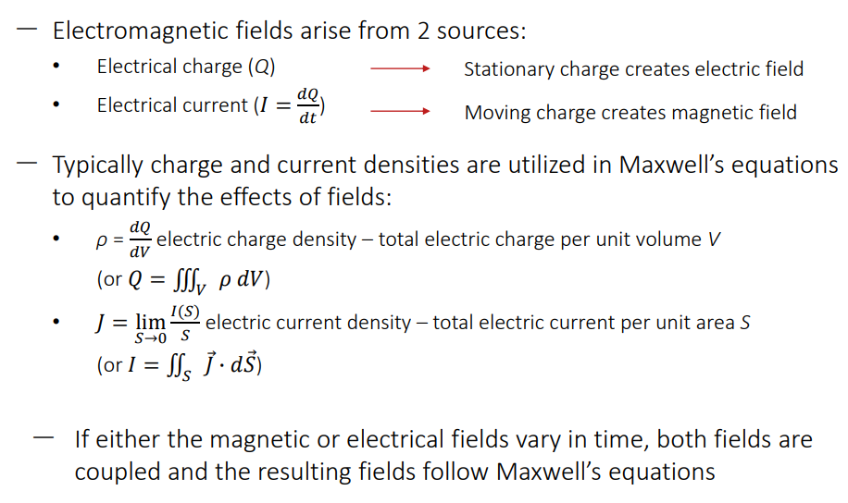
Sources of EM Fields

Slide 17
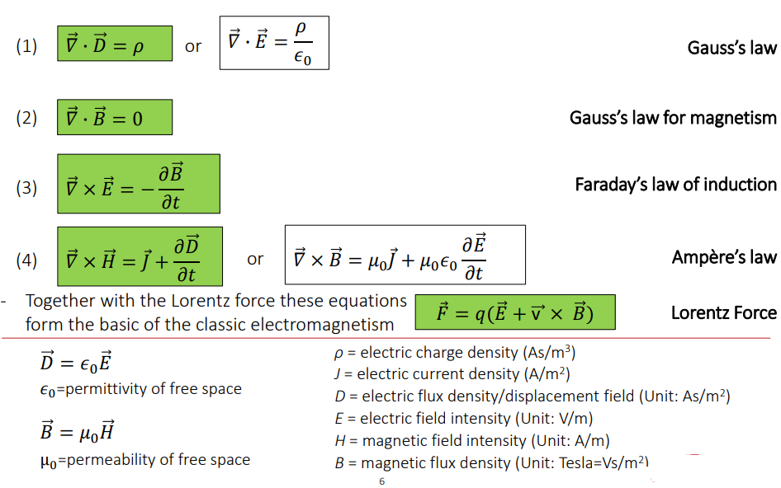
Maxwell’s Equation in differential form

Slide 18
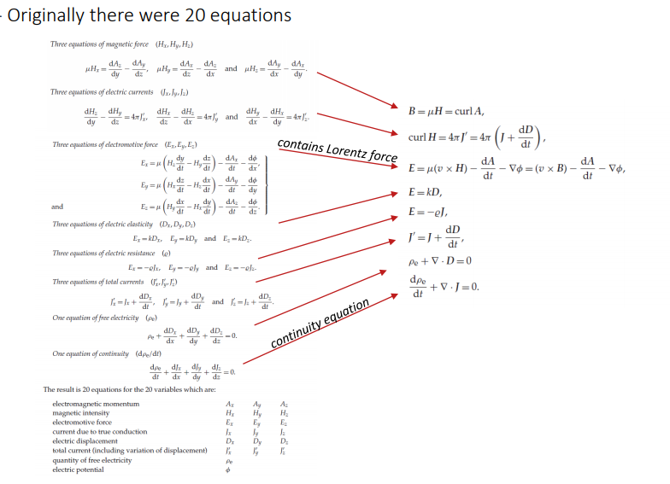
Maxwell’s Equations

